Slide 1

Informed Search
Artificial Intelligence
Instructor: M Zeeshan Aslam
Email: zeeshan.aslam@case.edu.pk

Slide 2
Outlines
Greedy Search
A* Search

Slide 3
Search Algorithm Terminologies
Searching is a step by step procedure to solve a search-problem in a given search space. A search problem can have three main factors:
Search Space: Search space represents a set of possible solutions, which a system may have.
Start State: It is a state from where agent begins the search.
Goal test: It is a function which observe the current state and returns whether the goal state is achieved or not.

Slide 4
Search Algorithm Terminologies
Search tree: A tree representation of search problem is called Search tree. The root of the search tree is the root node which is corresponding to the initial state.
Actions: It gives the description of all the available actions to the agent.
Transition model: A description of what each action do, can be represented as a transition model.
Path Cost: It is a function which assigns a numeric cost to each path.
Solution: It is an action sequence which leads from the start node to the goal node.
Optimal Solution: If a solution has the lowest cost among all solutions.

Slide 5
Properties of Search Algorithms
A strategy is defined by picking the order of node expansion.
Strategies are evaluated along the following dimensions:
Completeness: Does it always find a solution if one exists?
Time Complexity: number of nodes generated/expanded.
Space Complexity: Maximum number of nodes in memory.
Optimality: Does it always find a least-cost solution?

Slide 6
Properties of Search Algorithms
Time and space complexity are measured in terms of :
b: maximum branching factor of the search tree.
d: depth of the least-cost solution.
m: maximum depth of the state space (may be infinity).

Slide 7
Types of search algorithms
Based on the search problems we can classify the search algorithms into uninformed (Blind search) search and informed search (Heuristic search) algorithms.

Slide 8
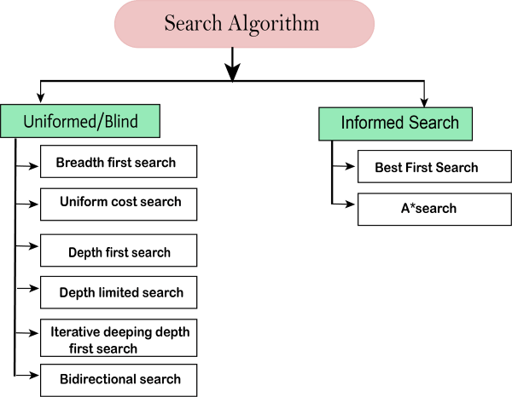
Search Algorithm

Slide 9
Best-first Search Algorithm (Greedy Search)
Greedy best-first search algorithm always selects the path which appears best at that moment.
It is the combination of depth-first search and breadth-first search algorithms.
It uses the heuristic function and search. Best-first search allows us to take the advantages of both algorithms. With the help of best-first search, at each step, we can choose the most promising node.
In the best first search algorithm, we expand the node which is closest to the goal node and the closest cost is estimated by heuristic function, i.e.
f(n)= g(n).

Slide 10
Best First Search
The general approach we consider is called best-first search. Best-first search is an instance of the general TREE-SEARCH or GRAPH-SEARCH algorithm in which a node is selected for expansion based on an evaluation function, f(n).
The evaluation function is construed as a cost estimate, so the node with the lowest evaluation is expanded first.
Special Cases:
Greedy Search
A* Search

Slide 11
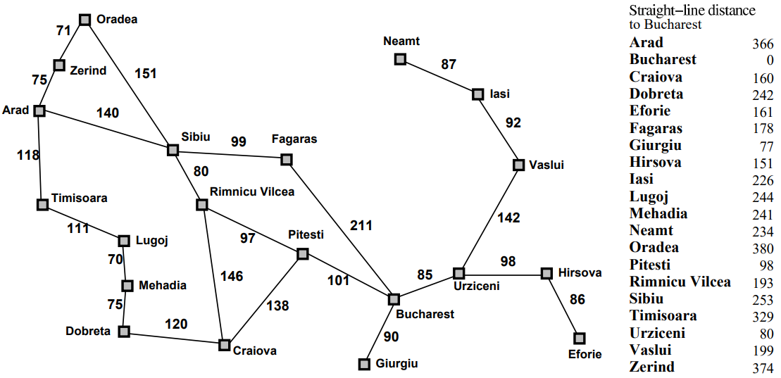
Romania with Step Costs

Slide 12
Greedy Search
Evaluation function h(n) (heuristic) = estimate of cost from n to goal
E.g. h_{SLD}(n) = straight line distance form n to Bucharest
Greedy search expands the node that appears to be closest to goal

Slide 13
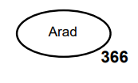
Greedy Search

Slide 14
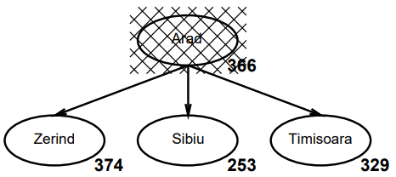
Greedy Search

Slide 15
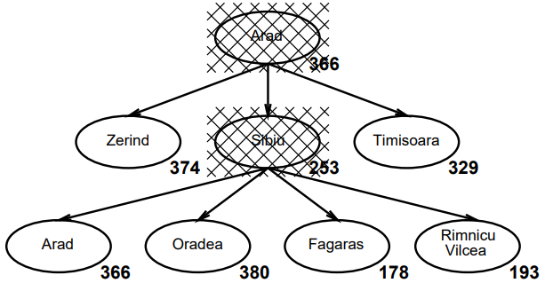
Greedy Search

Slide 16
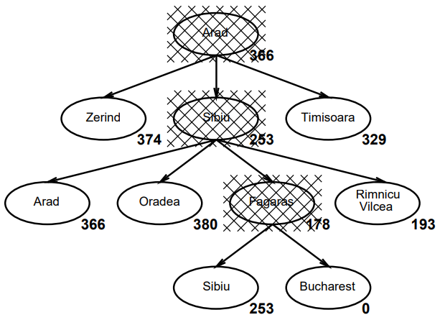
Greedy Search

Slide 17
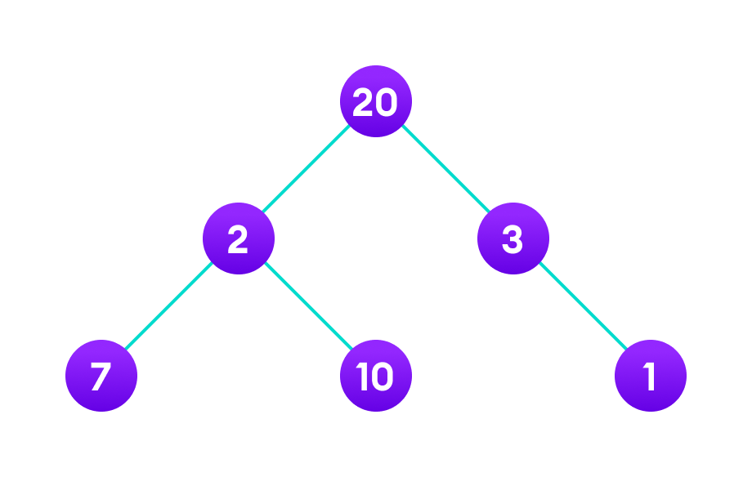
Task
Find the longest path in the graph below from root to leaf.

Slide 18
Properties of Best First Search (Greedy Search)
No: can be stuck in loops, e.g. lasi -> Neamat -> lasi -> Neamat.
Complete in finite space with repeated state checking
Complete?
Time Complexity?
Space Complexity?
Optimal?
O(b^{m}): but good heuristic can give dramatic improvement
O(b^{m}) keeps all nodes in memory
No

Slide 19
A* Search
Idea: Avoid expanding paths that are already expensive.
Evaluation function f(n) = g(n) + h(n)
g(n) = cost so far to reach n
h(n) = estimated cost to goal from n
f(n) = estimated total cost of path through n to goal
A* search uses an admissible heuristic i.e. h(n) ≤ h*(n) whare h*(n) is the true cost of n.
E.g. h_{SLD}(n) never overestimates the actual road distance

Slide 20
A* Search

Slide 21
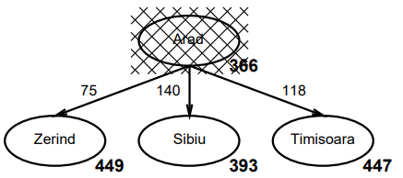
A* Search

Slide 22
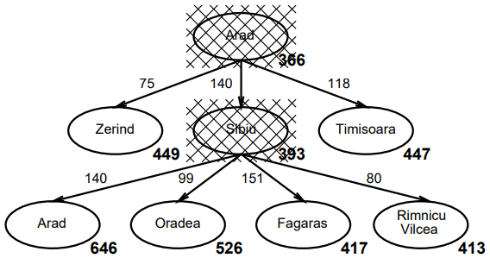
A* Search

Slide 23
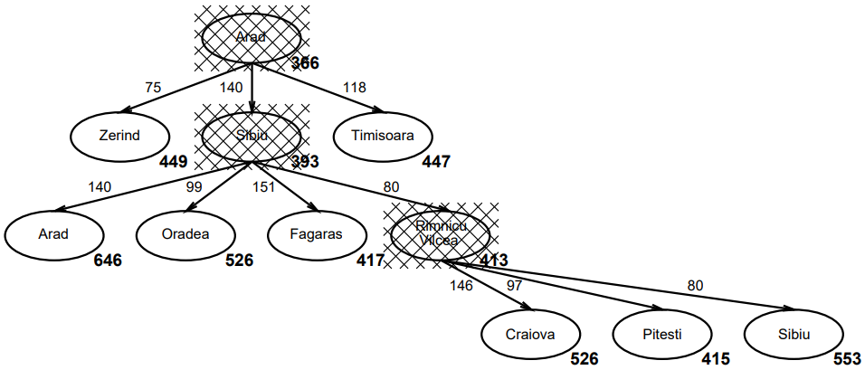
A* Search

Slide 24
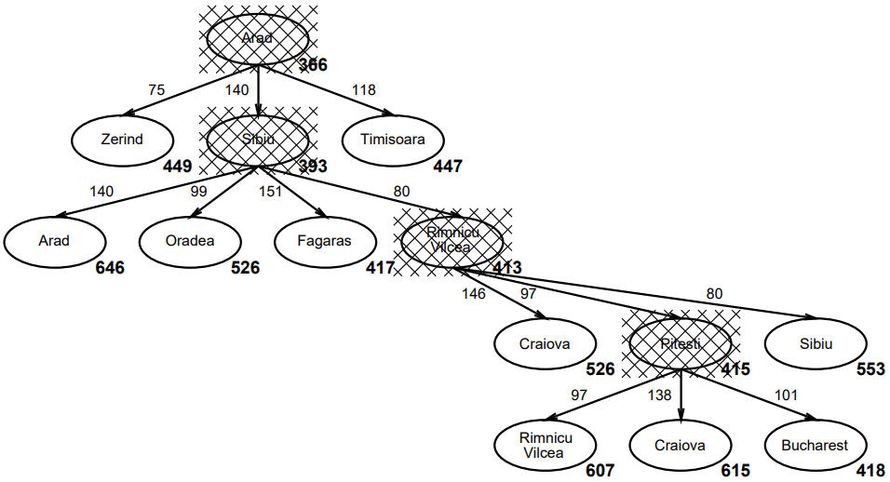
A* Search

Slide 25
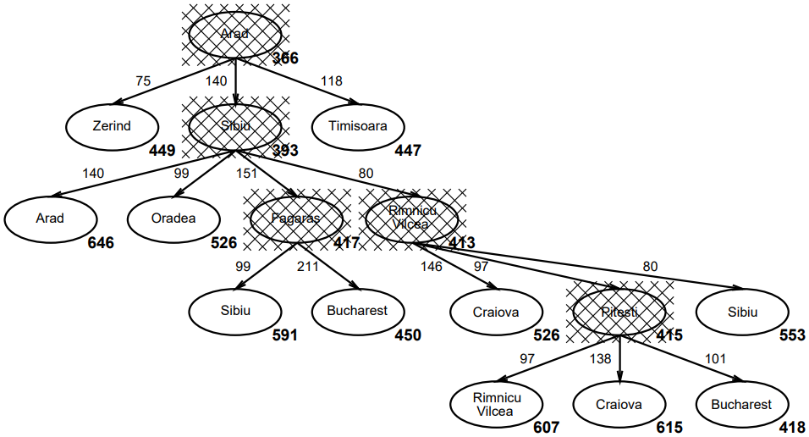
A* Search

Slide 26
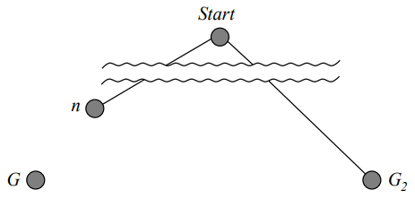
Optimality of A* (Standard proof)
Suppose some suboptimal goal G₂ has been generated and is in the queue. Let n be an unexpanded node on a shortest path to an optimal goal G₁.
f(G₂) = g(G₂) since h(G₂) = 0
> gG₁) since G₂ is suboptimal
≥ f(n) since h is admissible
Since f(G₂) > f(n), A* will never select G₂ for expansion

Slide 27
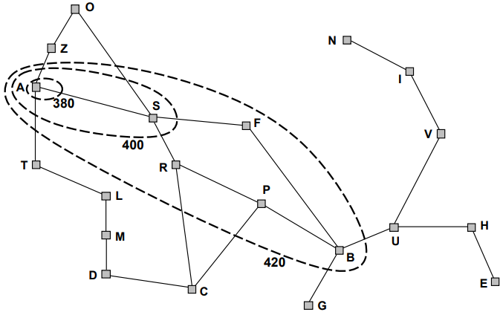
Optimality of A* (more useful)
Lemma: A* expands nodes in order of increasing f value
Gradually adds “f-contours” of nodes (of. Breadth first search adds layers)
Contour i has all nodes f = f_{i}, where f_{i} < f_{i + 1}

Slide 28
Properties of A* Search
Yes, unless there are infinitely many node with f ≤ f(G)
Complete?
Time Complexity?
Space Complexity?
Optimal?
Exponential in [relative error in h x length of solution
Keeps all nodes in memory
Yes, cannot expand f_{i + 1} until f_{i} is finished

Slide 29
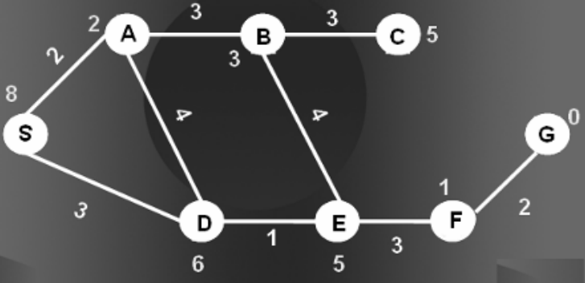
Task
Apply A* Search on the following graph.

Slide 30
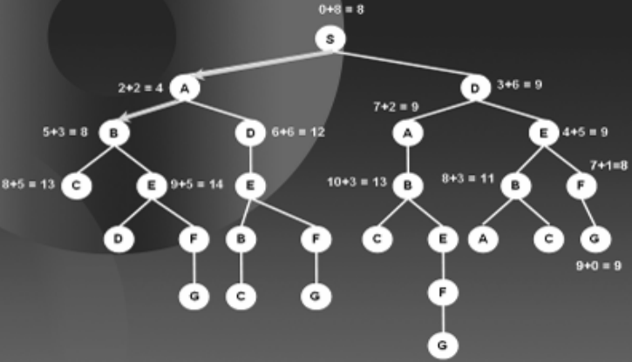
Solution

